Slide 1

Topic: Intro to Threads
Lecture: Dr. Zhao Jie
Date: 02/16/2026

Slide 2
Reading Assignment
Reading Assignment: Ch. 26

Slide 3
Agenda
Single-thread process
Multi-thread process
Thread structure
Thread implementation
Race condition

Slide 4
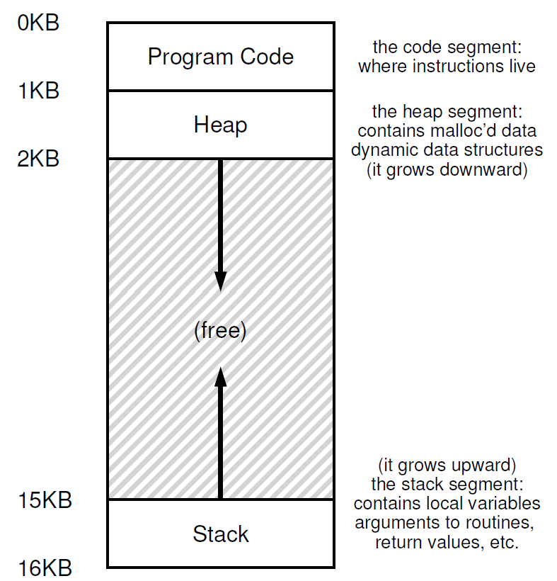
Motivation - 1
In retrospect, what are the components of a process?
If there is a need for an I/O request, will the process be blocked for I/O access?
If there are two processes, with the I/O request, does an increased number of process helps for efficient execution?

Slide 5
Motivation - 2
Introduction of the thread is necessary.
What is the thread?
The thread is a lightweight process.
There are two reasons to use Thread, not Process.
The first reason is parallelism
The second reason is non-blocking progress.
When a thread is blocked for an I/O request, the OS allows another thread to use CPU resources without incurring the costs of a context switch.
int arr1[3]
int arr2[3]

Slide 6
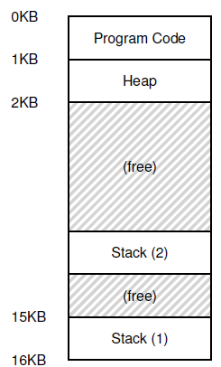
Thread structure
In a process, there can be many threads.
Each thread is independently executable.
Whereas threads share the same address space(code, heap)
Each thread has a separate PC
--- Each thread may run over a different part of the program
Each thread has a separate stack for independent function calls

Slide 7
Thread implementation
Thread creation
Use pthread_create() system calls
Thread synchronization
The use of pthread_join() is to make the process wait for the thread’s completion.
Thread function
As said before, each thread may run over a different part of the program. So, the thread can be regarded as a function.
Thus, using (void *) thread_function() is a way to fulfill the thread functionality.
The thread_function() is user-defined.
Pthread library

Slide 8
Scheduling threads
OS schedules threads that are ready to run independently, much like processes
The context of a thread (PC, registers) is saved into/restored from the thread control block(TCB)
--- Every PCB has one or more linked TCBs
Threads that are scheduled independently by the kernel are called kernel threads
--- E.g., Linux pthreads are kernel threads
In contrast, some libraries provide user-level threads
--- User program sees multiple threads
--- Library multiplexes larger number of user threads over a smaller number of kernel threads
--- Low overhead of switching between user threads (no expensive context switch)
--- But multiple user threads cannot run in parallel

Slide 9
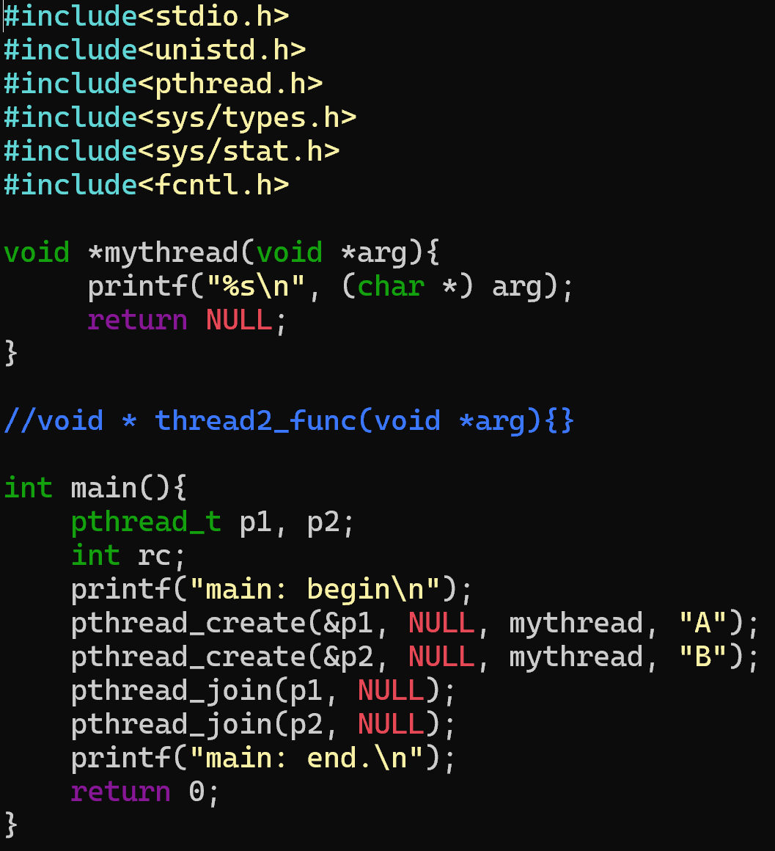
Creating threads using the pthreads API
Question
How many process(es)? How many thread(s)?
What are outputs?

Slide 10
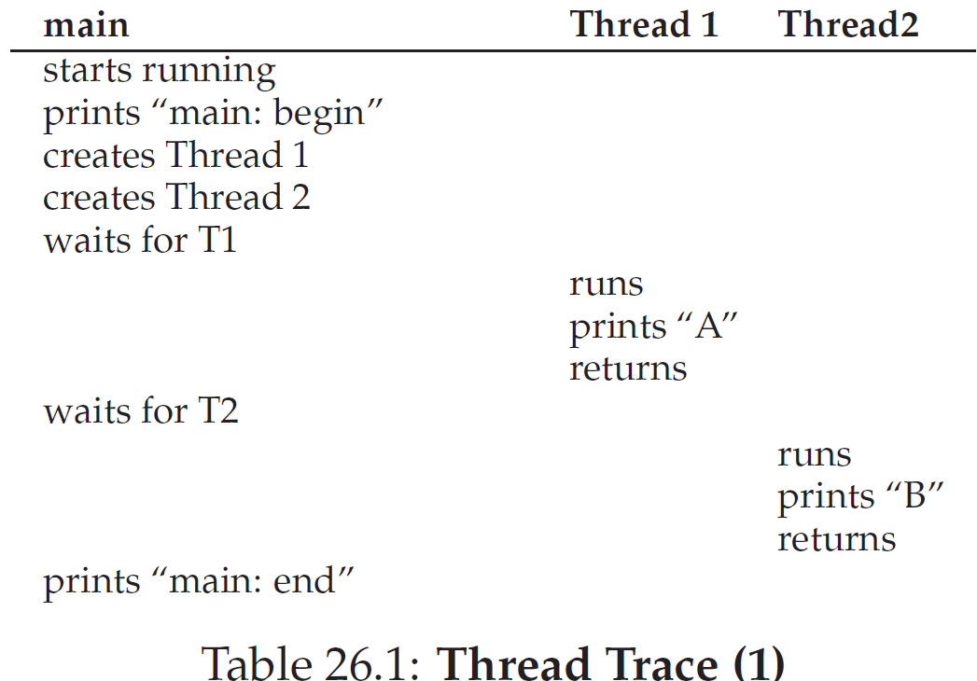
What is happening-1?
Trace table 1&3

Slide 11
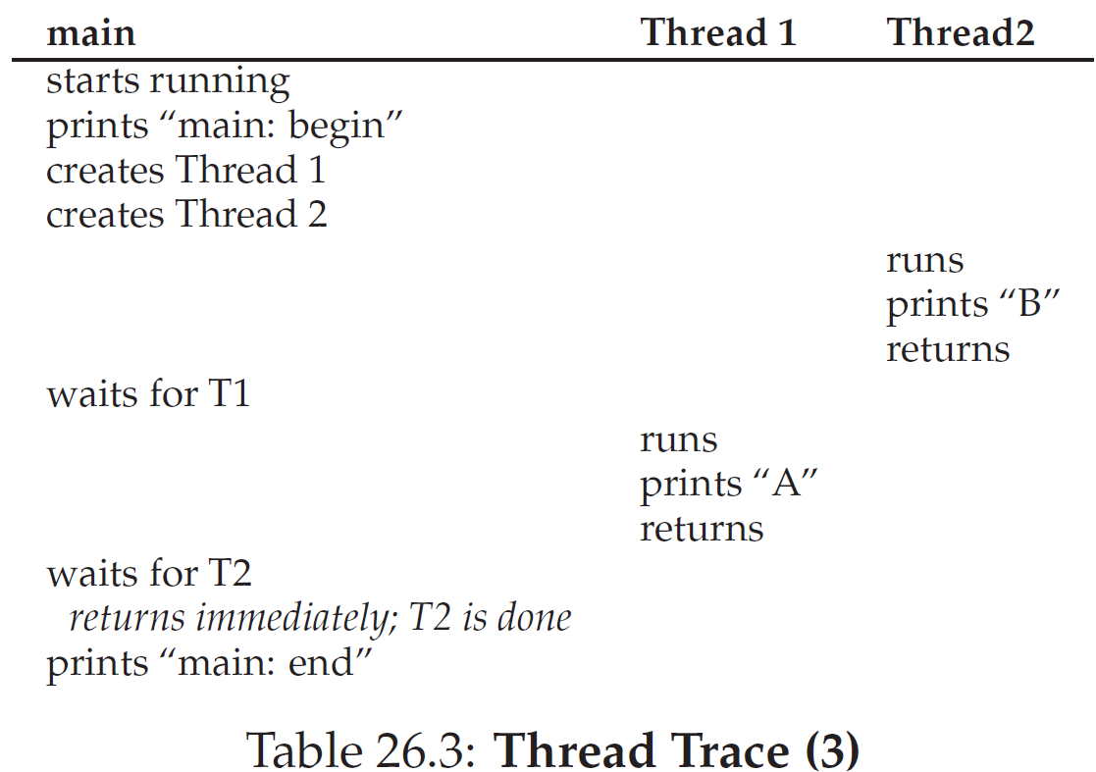
What is happening-2?
Trace table 1&3

Slide 12
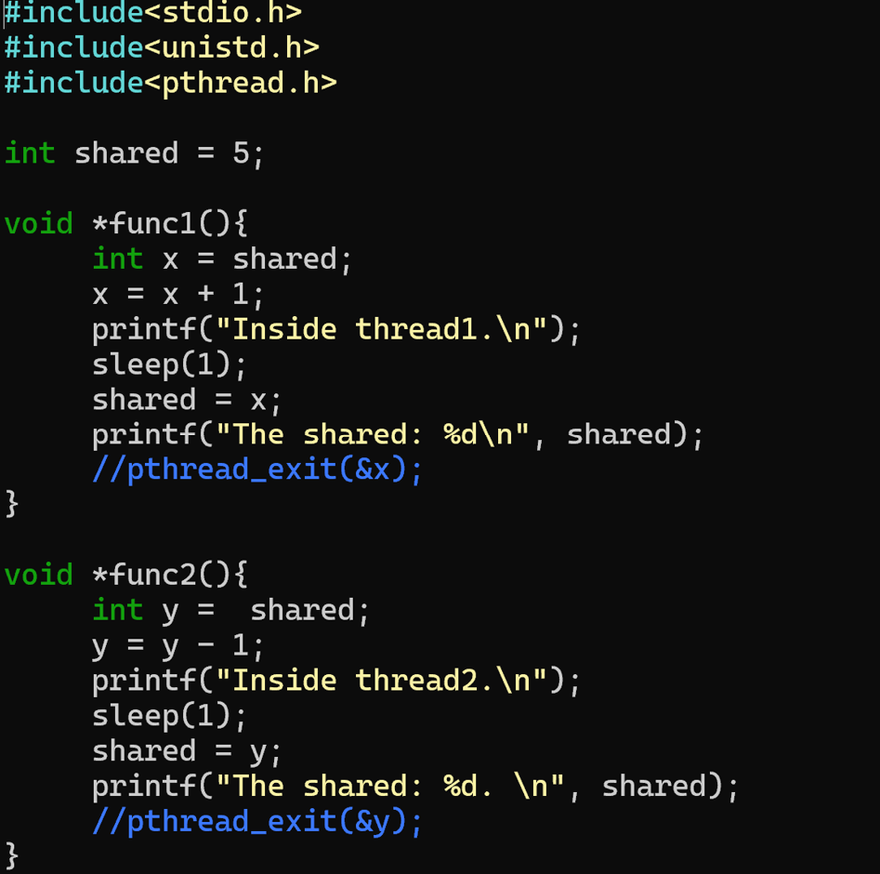
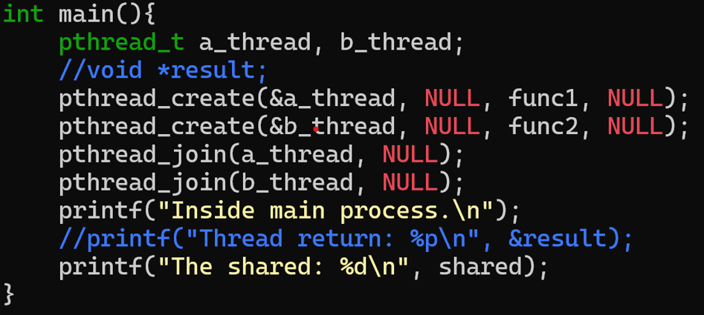
The example of shared data
Question
How many process(es)? How many thread(s)?
What are outputs?

Slide 13
Race conditions and synchronization
What just happened is called a race condition
--- Concurrent execution can lead to different results
Critical section: portion of code that can lead to race conditions
What we need: mutual exclusion
--- Only one thread should be executing critical section at any time
What we need: atomicity of the critical section
--- The critical sections should execute like one uninterruptible instruction
How is it achieved? Locks (topic of next lecture)

